Slide 1

Selenium, from automation to bot
@mris_ilmi

Slide 2
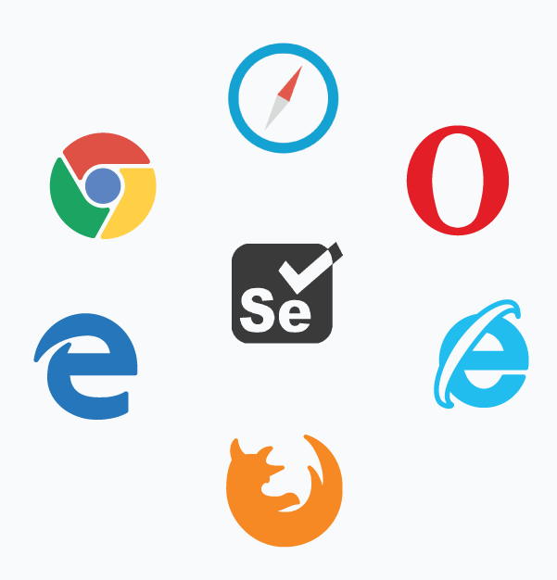
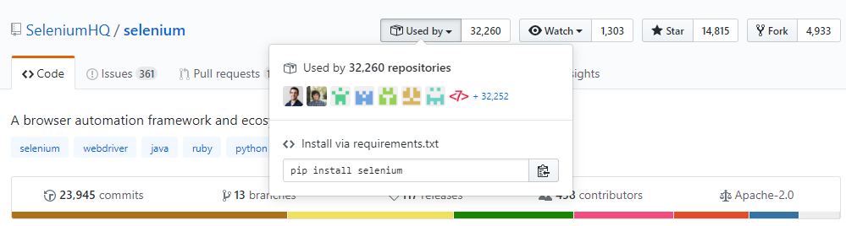
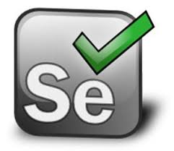
Selenium? 😕
It’s used mostly to test web applications. It automate modern web browsers.
Basically, Selenium is a framework to conduct software testing.
the most important thing is it’s open source!

Slide 3
au·to·mate
modern web browsers is a key

Slide 4
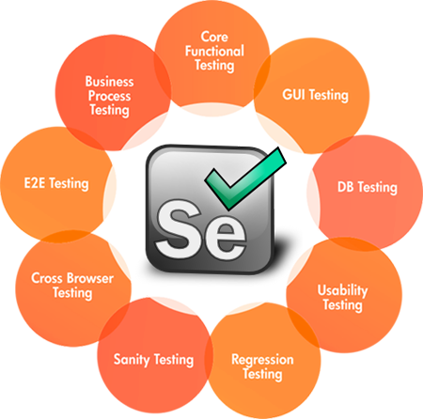

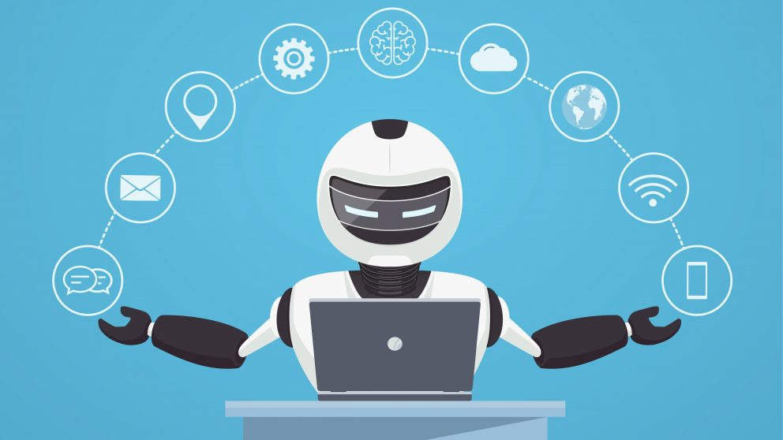
Could you imagine
what we can build with this tool?

Slide 5
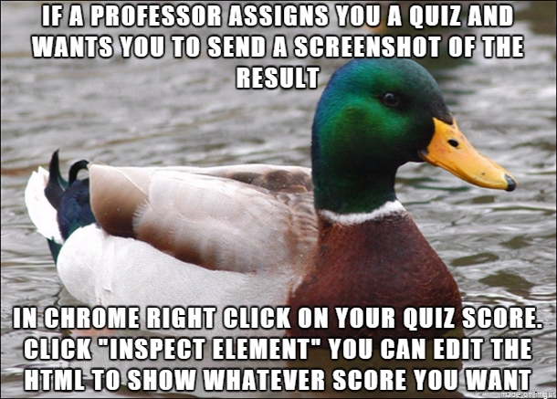
Creating a Bot using this tool? Is that hard?
if you have basic knowledge of web development such as html, css, and js then it is not harder than you thought.
at least you understand how to select an element in a single web page.
or you an experienced like the next img -->

Slide 6
It’s a demo time!
https://github.com/ilmimris/bagiilmu/01_Selenium_from_automation_to_bot

Slide 7

What’s your Idea ?
Make a bunch of list of elements in web.whatsapp.com and store in objects.
Wrap the object and make an API to easily control object and flow.
Make a higher abstraction like a “Bot Framework”.
Create module/plugin for the bot framework.
Bot ready to fly!

Slide 8
It’s a show time
bot framework is on progress.

Slide 9




Thank you
Contact me at :
ilmi.mris@gmail.com
linkedin.com/in/ilmimris/
github.com/ilmimris
@mris_ilmi
Knowledge increases by sharing
but not by saving.
Kamari aka Lyrikal
(*1978, Californian YouTube musician)
Disclaimer: All of images in this presentation downloaded from Google Images and Imgur and the credits belong to their creator.

